Slide 1



Analytics Analyst
Project Code:GEO 1327
Mary Lijo Cletus
Akshay Vijayan
Arshad Rafeek Shemi
Big Data Analytics – BDAT1011

Slide 2
Team Profile
Akshay Vijayan
Arshad Rafeek Shemi
Mary Lijo Cletus
Developer
Business Analyst
Data Analyst
Data analysis and data visualization
Managing proper communication between client and the team,
Data analysis
Managing cleaning and developing solutions from data
Development and testing

Slide 3
Website Analysis
As part of Analytics analyst project we have analyzed client websites
https://sharonbonnerconsulting.com/

Slide 4
Findings
Quality of the images are good
Size of the images has increased
Decrease in overall performance
The slider images in the first page has large size

Slide 5
Icons are not Displayed in the navigation Bar

Slide 6
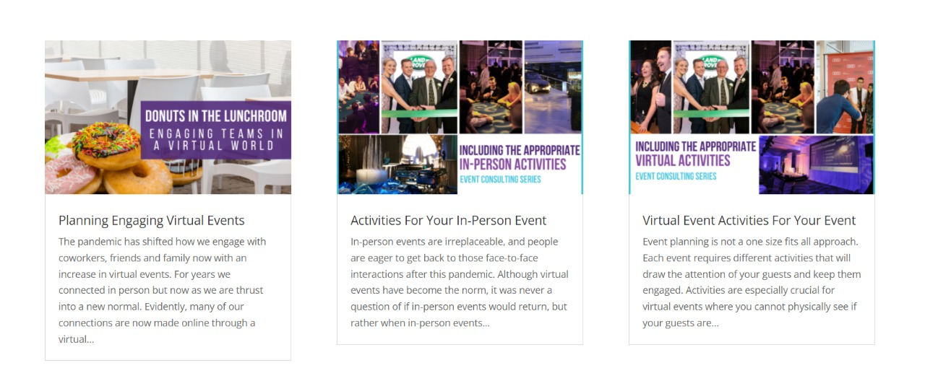
It is recommended that the three sections should follow a single rectangle size

Slide 7
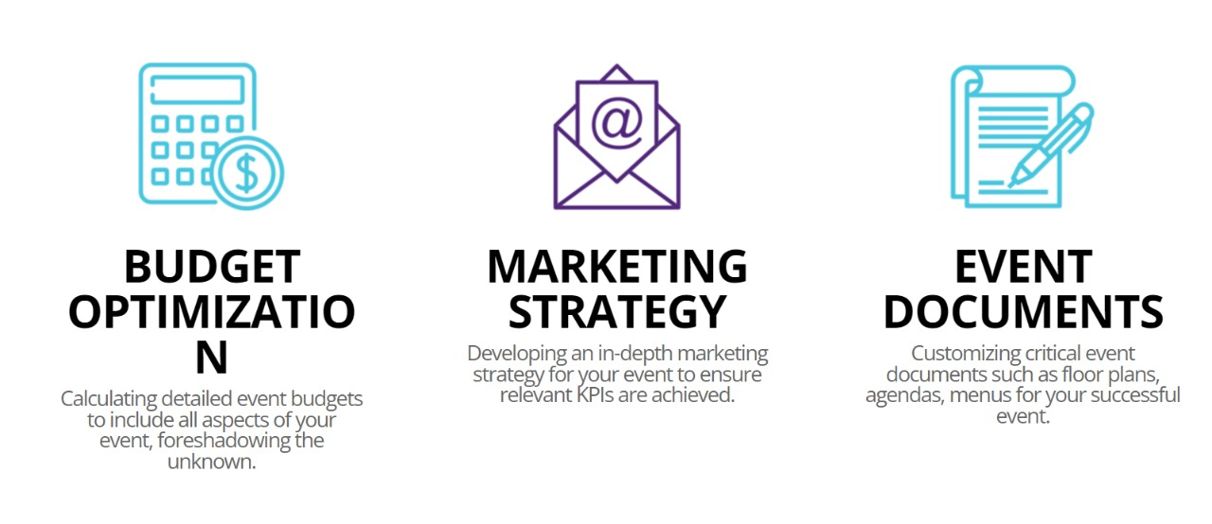
Findings
It will be good if all three icons are of same color
Can make “budget optimization “ in same line
Can add line spacing between the description under the icons

Slide 8


Slide 9


Slide 10
Social Media Analysis
Social Media Accounts are Excellent
Suggestions
Follow a theme or Pattern
Can Add main events in a separate section and tips and other contents in separate section
Can share messages and posts on Special Days and there by make an Impact

Slide 11
Thank you

